Slide 1

Customer Shopping Behavior Analysis
Uncovering insights into spending patterns and preferences to guide strategic business decisions.

Slide 2

Project Overview
1
2
Transactional Data
Key Insights
Analyzed 3,900 purchases across various product categories.
Spending patterns, customer segments, product preferences, subscription behavior.
3
Strategic Decisions
Guiding business strategy with data-driven insights.

Slide 3

Dataset Summary
3,900
18
37
Rows
Columns
Missing Values
Total purchases analyzed.
Features including demographics, purchase details, and behavior.
In Review Rating column, handled during cleaning.
Key features include customer demographics, purchase details, and shopping behavior.

Slide 4
Exploratory Data Analysis (Python)
01
02
03
Data Loading & Exploration
Missing Data Handling
Column Standardization
Imported dataset, checked structure and summary statistics.
Imputed missing Review Rating values using median.
Renamed columns to snake case for readability.
04
05
Feature Engineering
Database Integration
Created age_group and purchase_frequency_days.
Loaded cleaned data into PostgreSQL for SQL analysis.

Slide 5


Data Analysis (SQL) - Business Transactions
Revenue by Gender
Female: $75,191, Male: $157,890.
High-Spending Discount Users
839 customers identified.
Top 5 Products by Rating
Gloves, Sandals, Boots, Hat, Skirt.

Slide 6
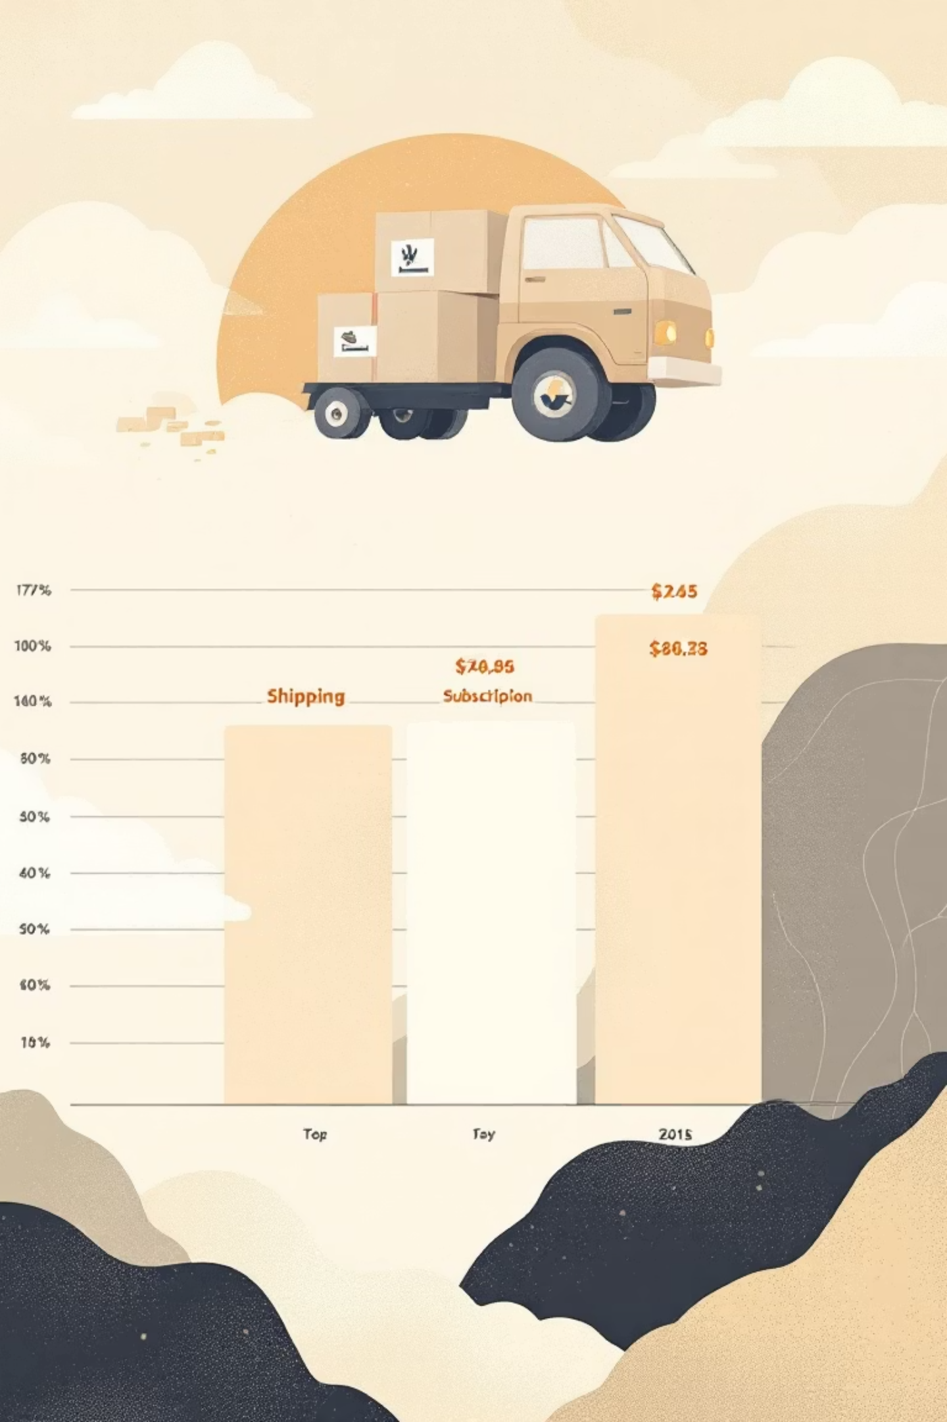
Data Analysis (SQL) - Shipping & Subscriptions
Shipping Type Comparison
Standard: $58.46, Express: $60.48 average purchase.
Subscribers vs. Non-Subscribers
Subscribers: 1,053 customers, $62,645 total revenue.
Discount-Dependent Products
Hat (50%), Sneakers (49.66%), Coat (49.07%).

Slide 7



Data Analysis (SQL) - Customer Segmentation
New
83 customers.
Loyal
3,116 customers.
Returning
701 customers.
Classified customers into New, Returning, and Loyal segments based on purchase history.

Slide 8
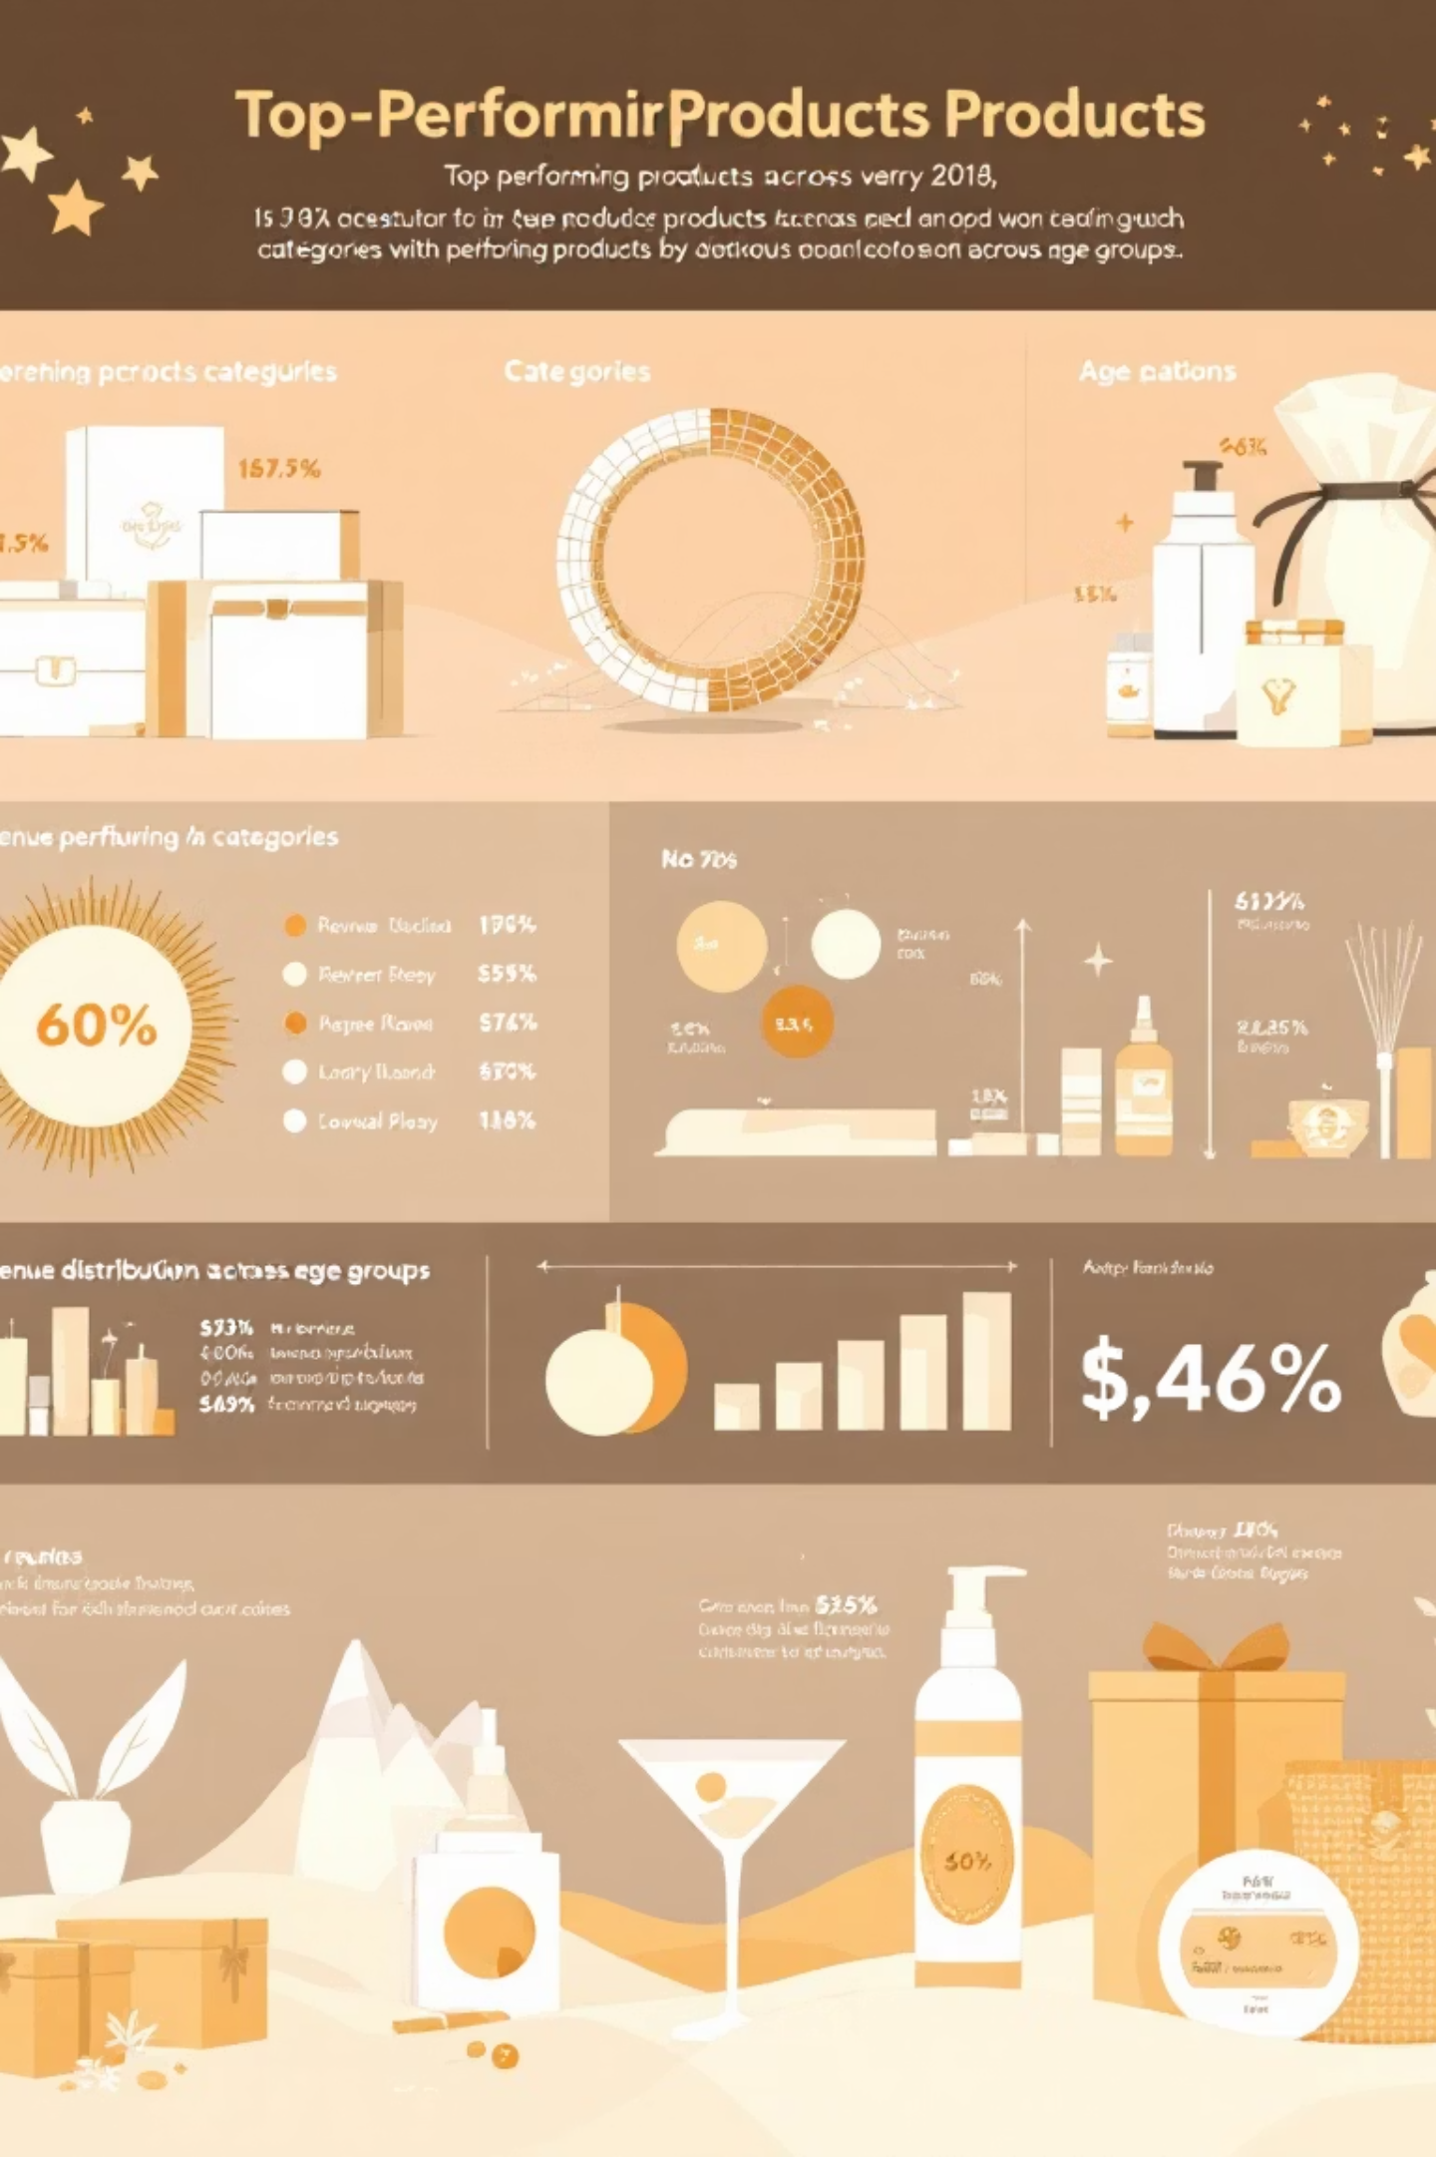
Data Analysis (SQL) - Product & Age Insights
Top 3 Products per Category
1
Jewelry, Sunglasses, Belt (Accessories); Blouse, Pants, Shirt (Clothing); Sandals, Shoes, Sneakers (Footwear); Jacket, Coat (Outerwear).
Repeat Buyers & Subscriptions
2
958 repeat buyers are subscribers, 2,518 are not.
Revenue by Age Group
3
Young Adult: $62,143, Middle-aged: $59,197, Adult: $55,978, Senior: $55,763.

Slide 9
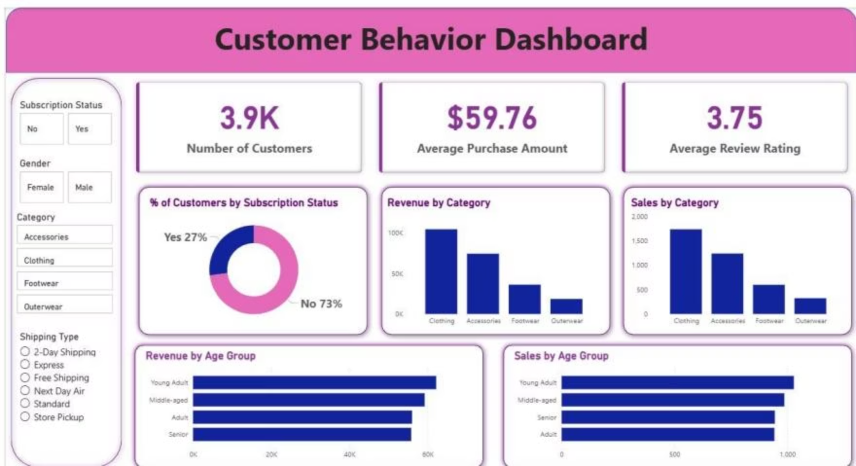
Dashboard in Power BI
Interactive dashboard presenting key insights visually.
73%
27%
Non-Subscribers
Subscribers

Slide 10





Business Recommendations
Boost Subscriptions
Promote exclusive benefits for subscribers.
Customer Loyalty Programs
Reward repeat buyers to foster loyalty.
Review Discount Policy
Balance sales boosts with margin control.
Product Positioning
Highlight top-rated and best-selling products.
Targeted Marketing
Focus on high-revenue age groups and express-shipping users.

